Slide 1

Storm on HDInsight
A .NET Developer journey
4th February 2016 | AZUG

Slide 2

Benny Michielsen
benny.michielsen@infosupport.com
@bennymichielsen
Consultant
MCT
Less talk more code
Programming, Motherfucker

Slide 3
Contents
Why
How
Scenarios

Slide 4


Introduction

Slide 5

Storm on HDInsight

Slide 6






HDInsight
Storm on HDInsight

Slide 7
Storm Sales pitch
Storm on HDInsight
Realtime Hadoop
Integrates with any queue / database
No data loss
Scalable
Fault tolerant

Slide 8

Storm 101

Slide 9



Lingo
Storm on HDInsight

Slide 10



Storm on HDInsight
Demo

Slide 11

Hashtagbattle!
http://azugtweetsweb.azurewebsites.net/
#azugbe
#azugbe-iot
#azugbe-storm
& whatever’s trending at the moment

Slide 12
Storm on HDInsight
Storm Bingo
ComponentStreamSchema | ShuffleGrouping | Bolt | HDInsight
Spout | Ack | Parallel | OutputSchema
Storm | Tuple | Worker | Emit
Apache | SCPHost.exe | SCP.NET | Topology

Slide 13
Shuffle Grouping
Storm on HDInsight
{}
{}
{}

Slide 14
Global Grouping
Storm on HDInsight
{}
{}
{}

Slide 15
All Grouping
Storm on HDInsight
{}
{}
{}
{}

Slide 16
Field Grouping
Storm on HDInsight
{field=a}
{field=a}
{field=b}

Slide 17
Field Grouping
topologyBuilder.SetBolt(
typeof(TransformAllTheThingsBolt).Name,
TransformAllTheThingsBolt.Get,
new Dictionary<string, List<string>>()
{
{ "Transformation", new List<string> {"hubId", "sensorId", "readout" } }
},
eventHubPartitions,
true)
.DeclareCustomizedJavaSerializer(javaSerializerInfo)
.shuffleGrouping("com.microsoft.eventhubs.spout.EventHubSpout");
topologyBuilder.SetBolt(
typeof(StoreAllTheThingsBolt).Name,
StoreAllTheThingsBolt.Get,
new Dictionary<string, List<string>>()
{},
eventHubPartitions,
true)
.fieldsGrouping(typeof(TransformAllTheThingsBolt).Name, new List<int> { 0, 1 });

Slide 18
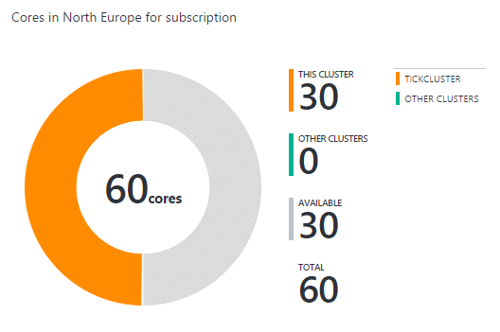

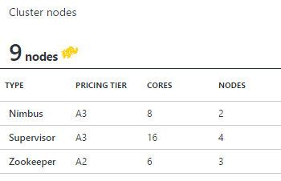
Cluster
Storm on HDInsight
Nimbus
Zookeeper
Supervisor

Slide 19

Scenarios

Slide 20
have i been pwned
Notes:
http://www.troyhunt.com/2015/04/orchestrating-massive-parallelisation.html

Slide 21
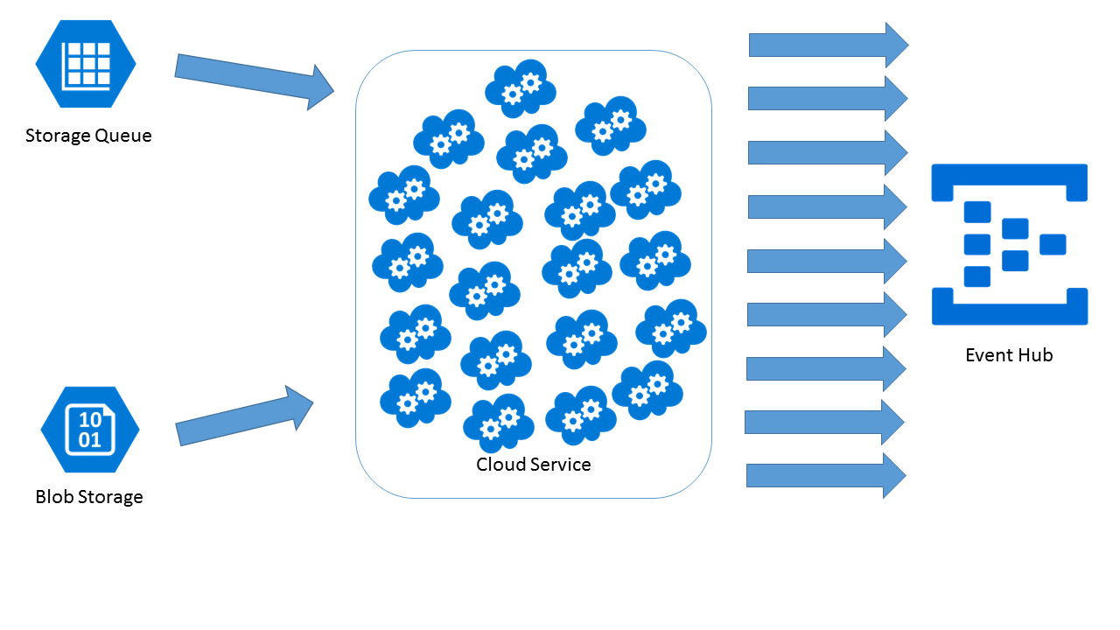
Storm on HDInsight
Notes:
<2 hours to fill up eventhub

Slide 22

Topology
Storm on HDInsight
Eventhubspout
TableStorageBolt
SQLAzureBolt
Notes:
Sql batch 1000 or time

Slide 23
Hybrid topology
Storm on HDInsight
JavaComponentConstructor constructor = JavaComponentConstructor.CreateFromClojureExpr(
string.Format(@"(com.microsoft.eventhubs.spout.EventHubSpout. (com.microsoft.eventhubs.spout.EventHubSpoutConfig. " +
@"""{0}"" ""{1}"" ""{2}"" ""{3}"" {4} ""{5}""))",
eventHubPolicyName,
eventHubPolicyKey,
eventHubNamespace,
eventHubName,
partitionCount,
""));
topologyBuilder.SetJavaSpout(
"EventHubSpout",
constructor,
partitionCount);

Slide 24
Performance
Storm on HDInsight
16 Spouts
256 Table Storage Bolts
2 SQLBolts (S3 instance)
10 million per hour

Slide 25
Attempt #2
Storm on HDInsight
Shufflegrouping
Fieldgrouping
Eventhubspout
LookupTableStorage
InsUpTableStorage

Slide 26
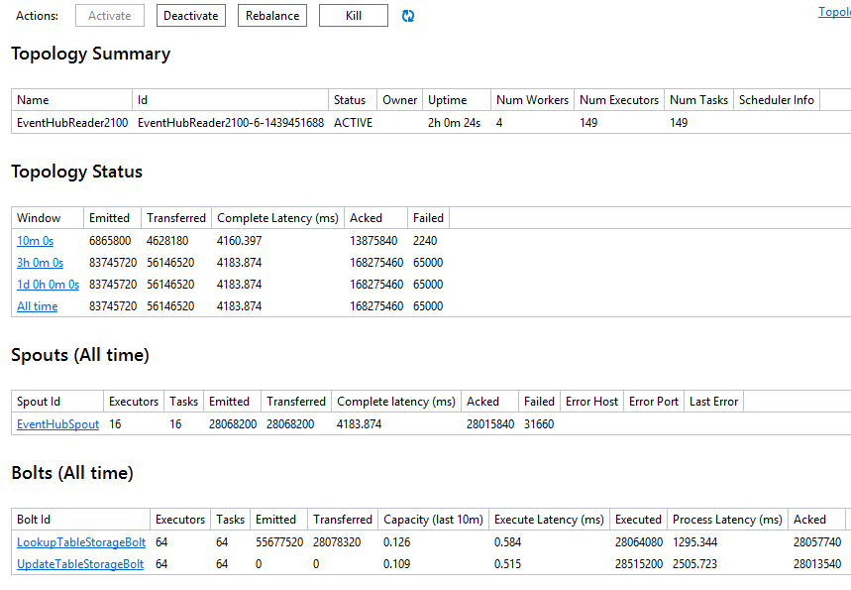
Storm on HDInsight
Notes:
14-15 million records per hour

Slide 27
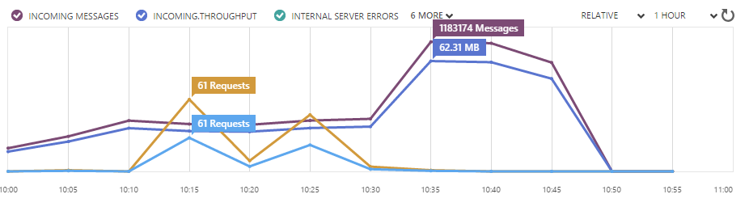
Scaling up the event hub

Slide 28
Tick Tack

Slide 29


Tick Tack
Storm on HDInsight

Slide 30
Sensor Topology
Storm on HDInsight
Table Storage Bolt
Alert usage
Unexpected Use Bolt
EventHub Spout
Transformation Bolt
Enrich Bolt
Last Minutes usage
Last Five Minutes usage

Slide 31
EventhubSpout
Storm on HDInsight
topologyBuilder.SetEventHubSpout(
"com.microsoft.eventhubs.spout.EventHubSpout",
new EventHubSpoutConfig(
ConfigurationManager.AppSettings["EventHubSharedAccessKeyName"],
ConfigurationManager.AppSettings["EventHubSharedAccessKey"],
ConfigurationManager.AppSettings["EventHubNamespace"],
ConfigurationManager.AppSettings["EventHubEntityPath"],
eventHubPartitions),
eventHubPartitions);

Slide 32
Tick Tuples
Storm on HDInsight
public class UsagePastFiveMinutes
: Microsoft.SCP.ISCPBolt
{
public void Execute(SCPTuple tuple)
{
if(tuple.GetSourceStreamId() == Constants.SYSTEM_TICK_STREAM_ID)
{
foreach (var sensor in _readings)
{
var fiveMinutesAgo = DateTime.UtcNow.AddMinutes(-5);
sensor.Value.RemoveAll(x => x.ReadingOn <= fiveMinutesAgo);
//do some more work
}
}
else
{
//add data to the batch
}
}
}

Slide 33


Benny Michielsen
@bennymichielsen
bennym@infosupport.com
bennymichielsen.be

Slide 34
Thanks!

